Slide 1


Final Presentation about Global Internet Users
——Written by Group S11
Group S11 members
Siyu CHENG Qinshu DU,
Xinran GAO Jiamin LIN,
Lixin WAN Qi XU,
Yuying ZHANG Yiyang ZHENG

Slide 2

Part one
Data Introduction
Data Preprocessing

Slide 3

Data Description
Variable | Data Type
year | ordinal
Country name | nominal
Country code | nominal
Internet user count | Interval
Internet user percentage (%) | Interval
Broadband subscription | Interval
Cellular subscription | Interval
1980 - 2020
Global Internet Users
8867 observations
https://www.kaggle.com/datasets/ashishraut64/internet-users/data

Slide 4
Background & Motivation
In this project, we can use the data to analyze the temporal and spatial differences in the development of the Internet from 1980 to 2020 and find out relations among countries, time and the number and proportion of Internet users, which can give us a further understanding of the evolution of the internet. Based on this, we used a variety of analysis tools to conduct a detailed analysis, as detailed in the report below.

Slide 5
Expected Findings
.
Countries that are more economically developed have a faster growth in internet users.
The internet user growth shares similar trends with the cellular / broadband service growth.
The internet development of a country will be deeply affected by its economic growth (i.e., GDP).
Notes:
Lim, J., Nam, C., Kim, S., Rhee, H., Lee, E., & Lee, H. (2012). Forecasting 3G mobile subscription in China: A study based on stochastic frontier analysis and a Bass diffusion model. Telecommunications Policy, 36, 858-871.

Slide 6

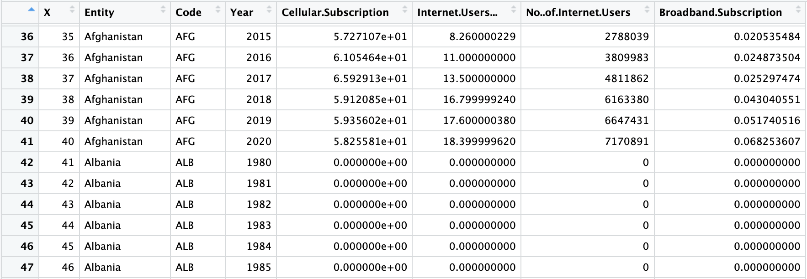
Preparation for Analysis: Data Preprocessing
Step 1: remove empty rows, reject useless column
Step 2: impute missing values
Notes:
Step 1: remove empty rows, reject useless column. We observed that the rows before the year 1990 were almost empty with a value of zero. Since the Internet has not been developed before 1990, there might be few large Internet services in those years and it is in line with the missing observations. So we dropped these rows and only studied the values between 1990 and 2020 (except overall analysis). We also omitted the column country code, which is duplicated with the country name.
Step 2: impute missing values. We used different imputation techniques to ensure the data is consistent for analysis. For a value of 0 or NA between two values in the same column, we choose to take the average; for a value of 0 or NA that suddenly becomes 0 or NA after a certain year, we use the data from the last year with a value to fill in the missing value.

Slide 7
Part two
Data Exploration & Analytics
(Steps of analysis and main findings)

Slide 8
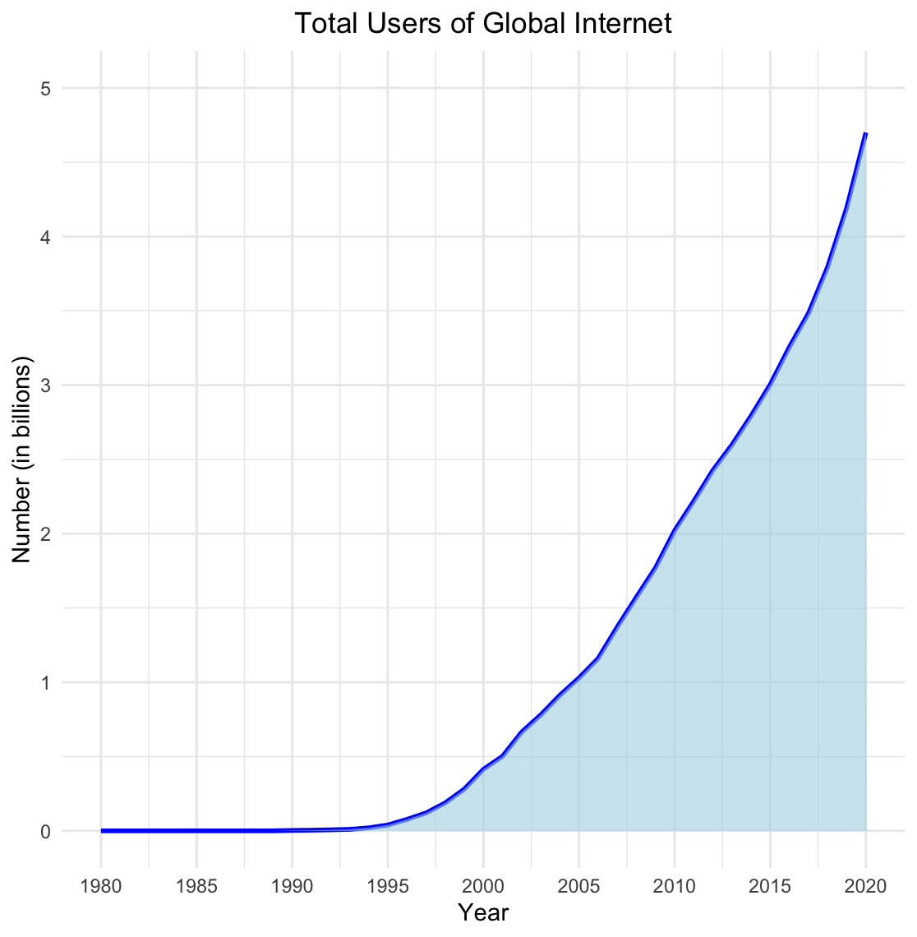

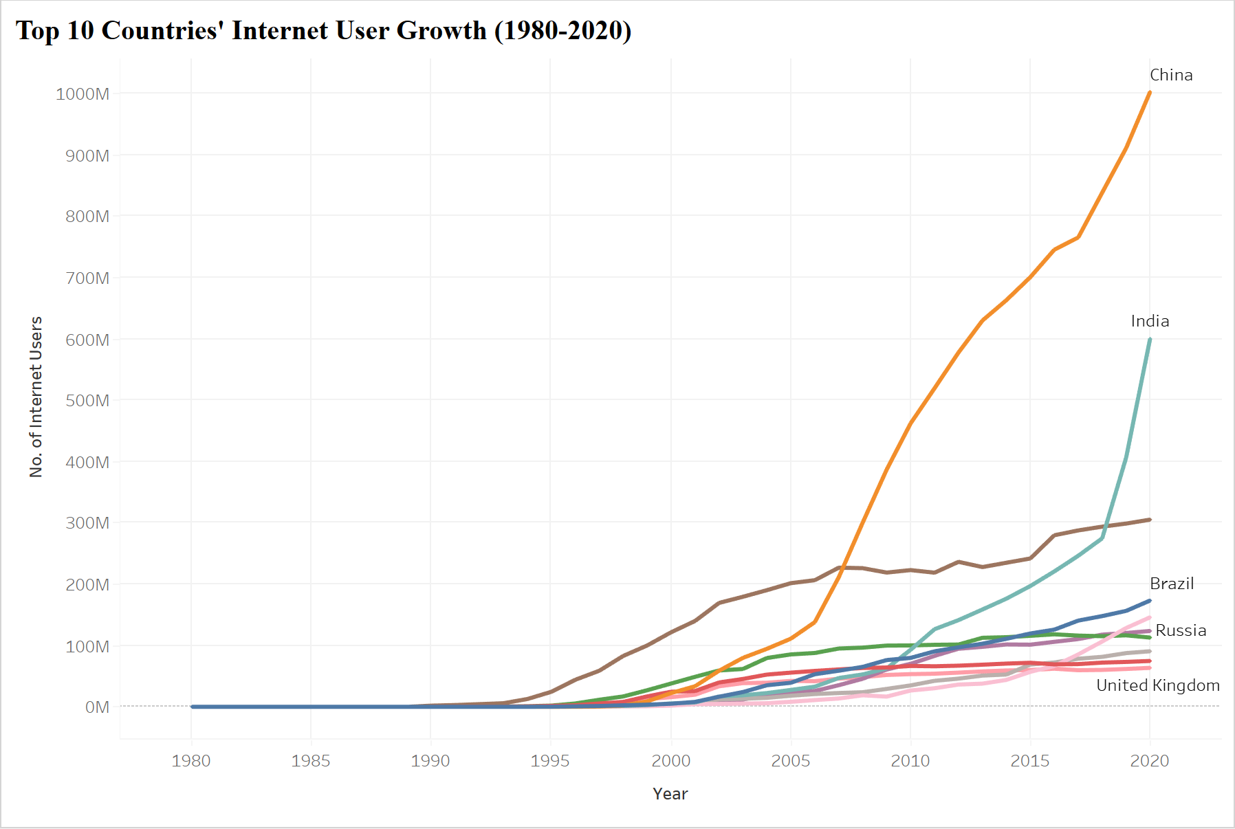
Overview: Internet Growth Globally
Before 1990, the number of internet users remained at zero levels. Starting from the mid-1990s, the number of users began to rise significantly, especially after the year 2000, creating a steep upward curve.
On the right is a time-series plot for the 10 countries with most internet users in 2020. The overall trend copes with the entire picture, but the growth rates in each specific countries are different.

Slide 9
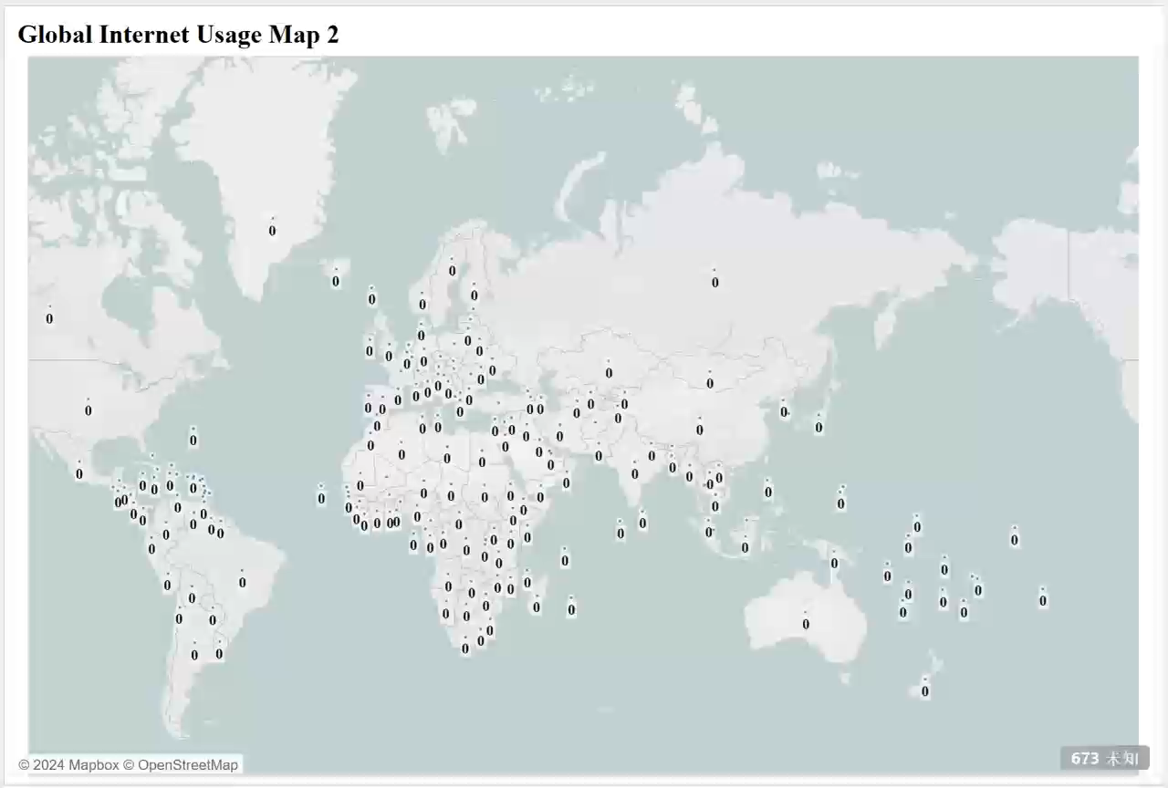

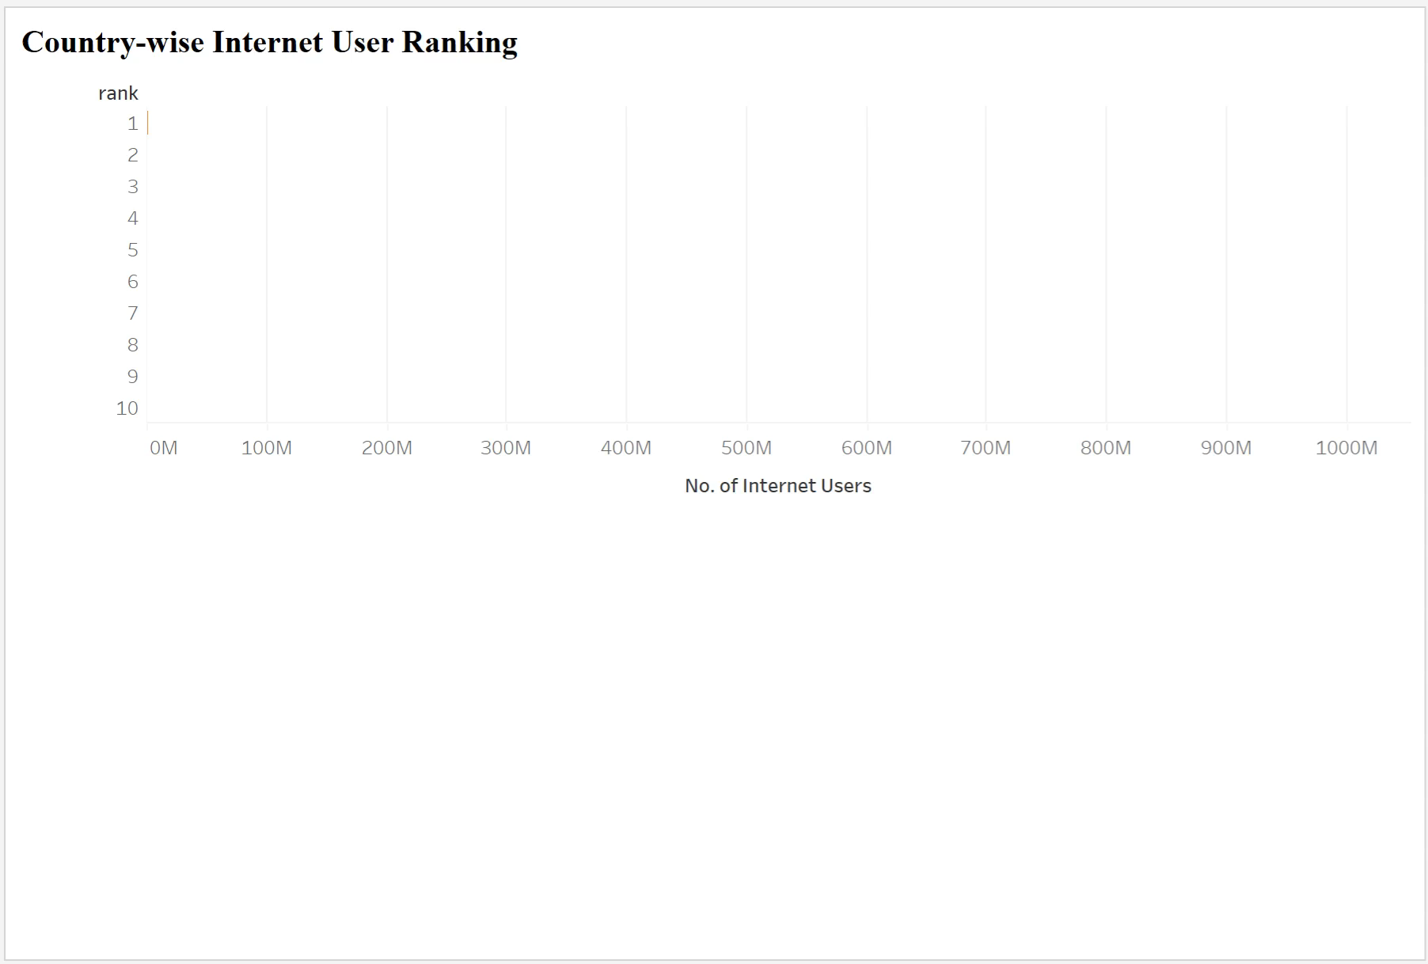
Global Internet User Count
China leads with over 1 billion users, followed by India with 600 million, and United States with approximately 300 million.
Problem with the absolute number approach: countries with larger populations such as India and China have more internet users. However, their internet penetration rate may not be high.

Slide 10
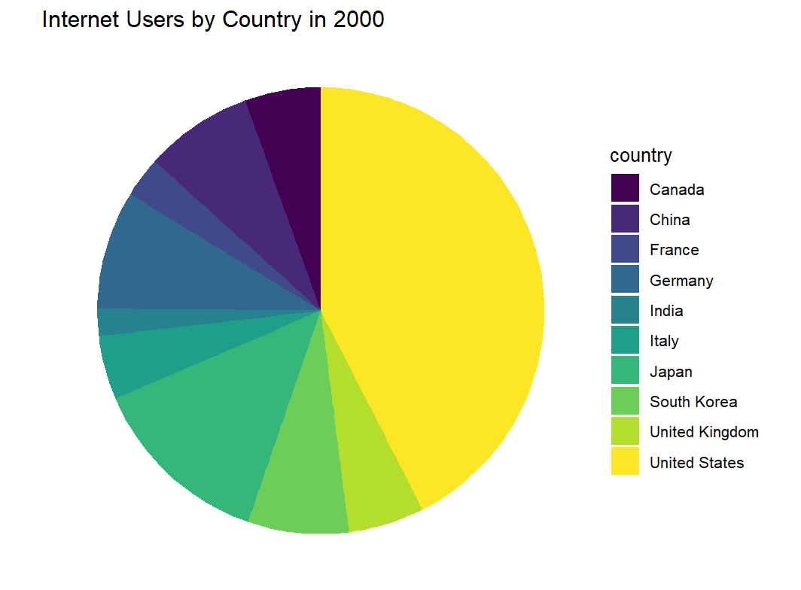
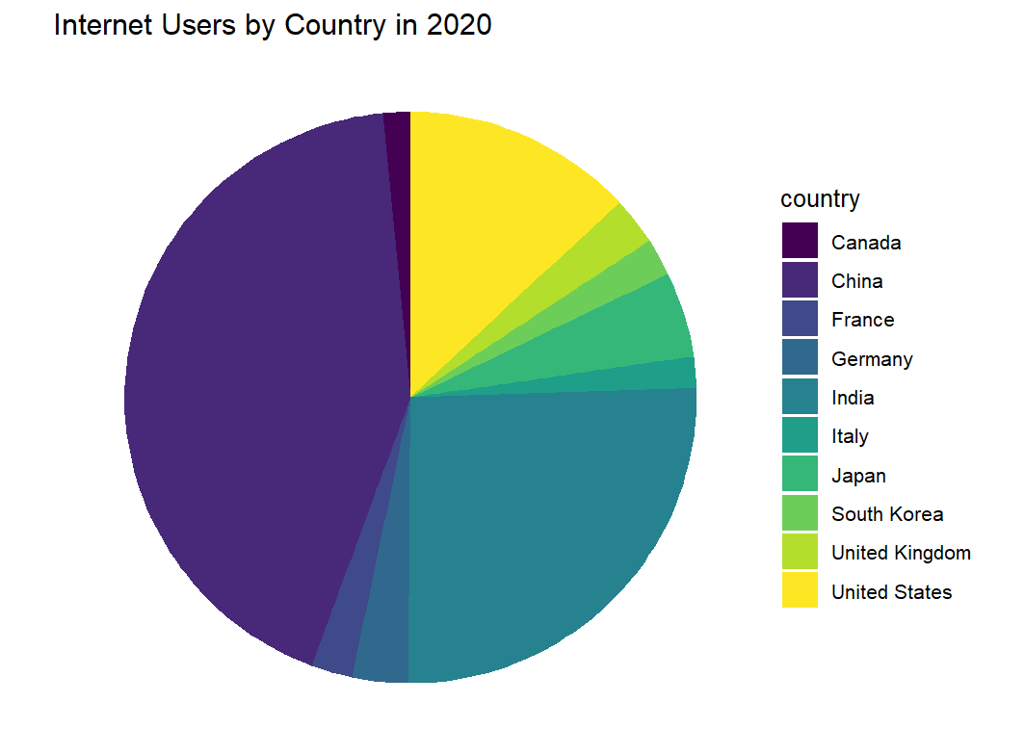
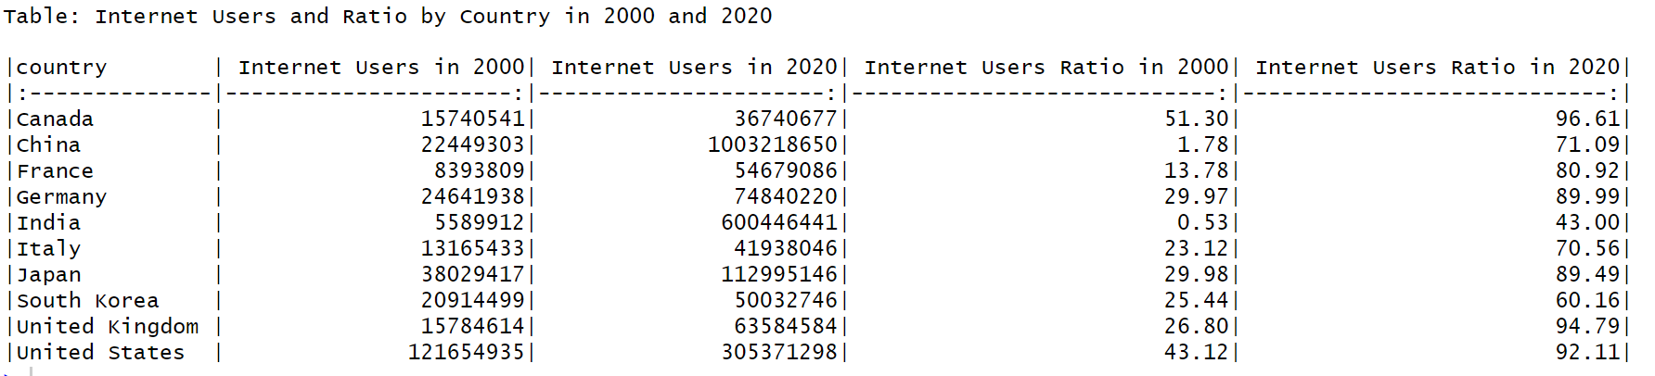
Analysis of Internet User Distribution from 2000 to 2020
Internet Users by country from 2000 to 2020
Different economic status gives different internet development pace
Notes:
The reason why we selected these two years for comparison:
2020: this is the final year of observation
2000: the reason why we did not select 1990, the start year of observation, is that we think there might be too little data in that year for analyzing global trends. Since we found in our first phase of analysis that the internet user number started to explode after the year 2000, we decided to use this year’s data to find the patterns of global internet development in the early stage.

Slide 11
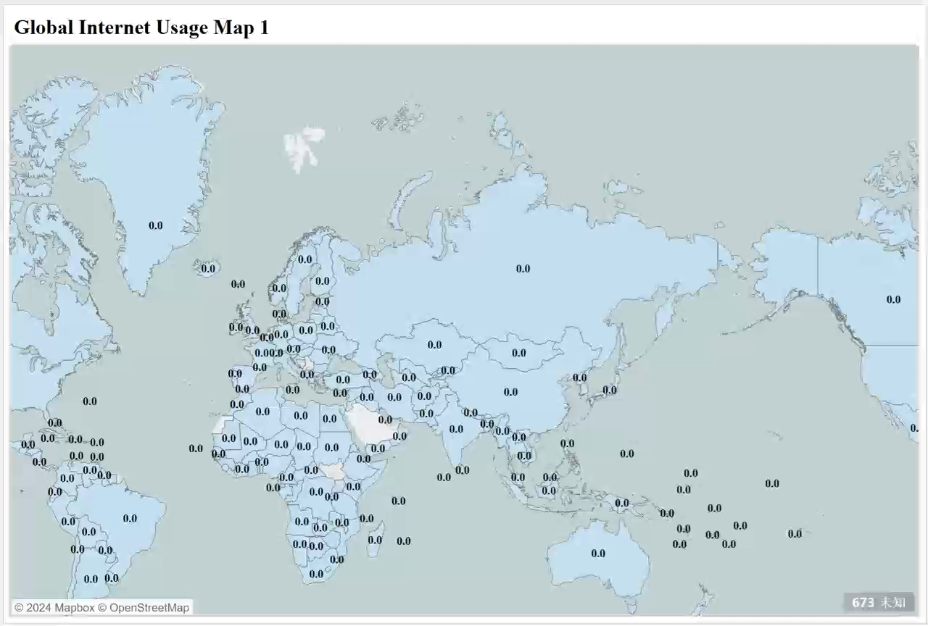
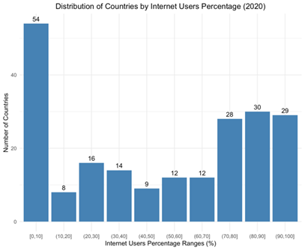
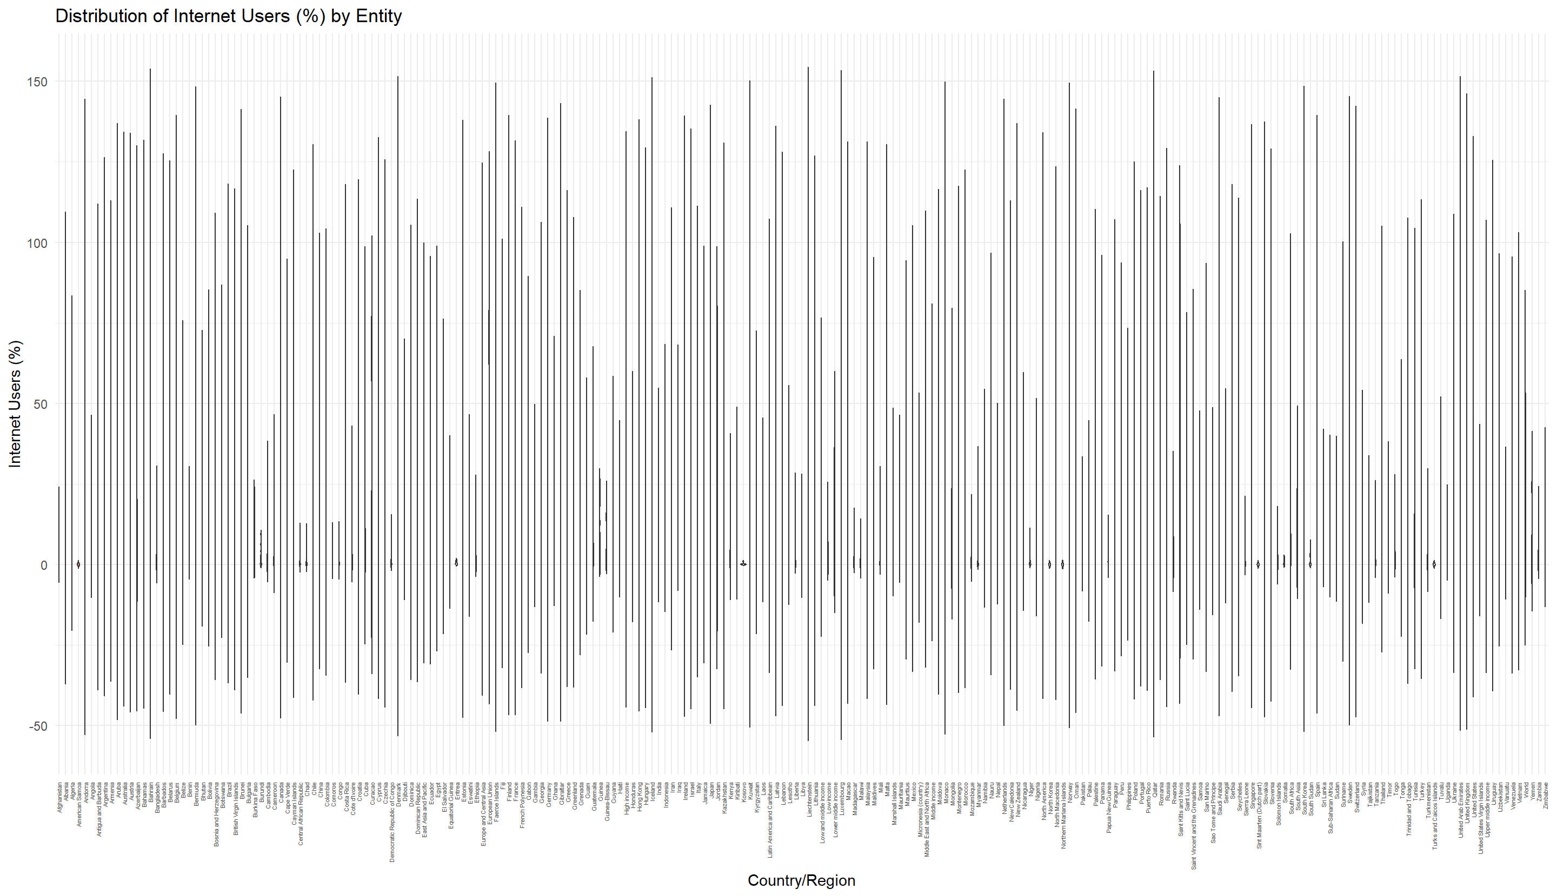
Global Internet Penetration Rates (%)
Distribution of internet user percentage (over time) by country
Notes:
China indeed has a lower internet penetration rate (i.e., at about 70% in 2020) than those developed countries which have an average over 90%.
The growth in internet penetration rate is uneven across countries.

Slide 12
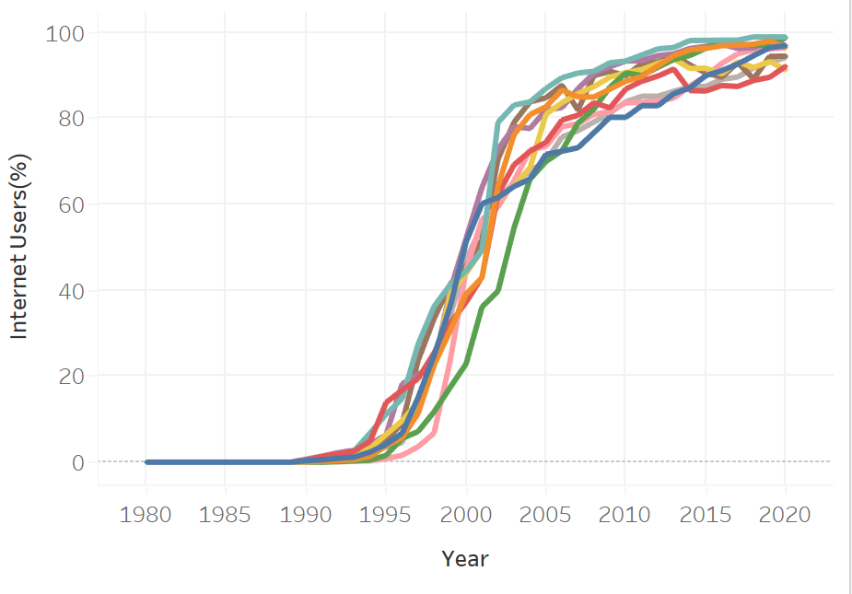
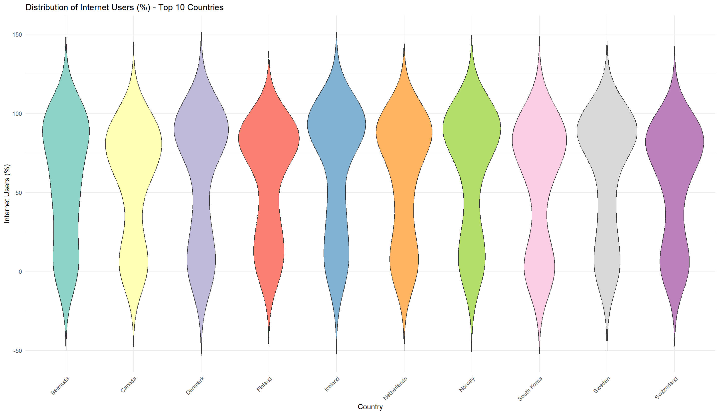
The Trend of Increasing Internet Penetration (%)
The growth of internet penetration rate is very rapid within a relatively short period of time (i.e., from about 1995 to 2005) and most countries in the chart show similar trends, converging toward 100% penetration by 2020.
The violin plot shows results which are in line with the left plot. There is one peak at around 0% and one peak at around 90% because the internet penetration rates grew very fast within a few years in the middle while it stayed at the top and bottom for longer periods.
Notes:
One surprising finding here: from the violin plot on the right, we can see that the United States is not in the list of top 10 countries in internet user percentage (in 2020).

Slide 13
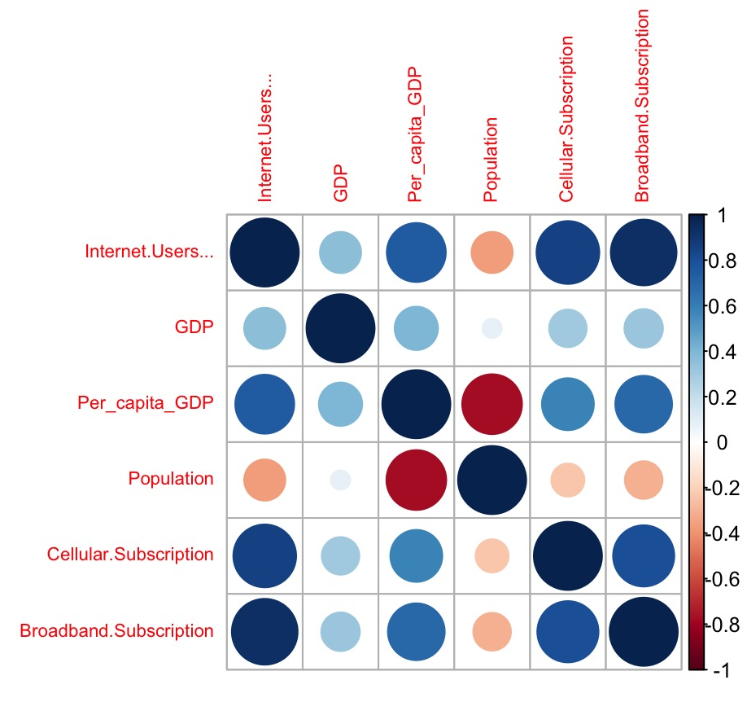
Correlation Matrix
Correlation coefficient
Heat map
Internet User (%)
GDP: 0.3671492
Per_Capita_GDP: 0.7507523
Population: -0.3658298
Cellular.Subscription: 0.8507285
Broadband.Subcription: 0.9319016
Total score
high correlation：
Natural&Science，highly citied, awarded Nobel ，alumni with Nobel
low correlation：year
High correlation
Natural&Science - highly citied
alumni with Nobel - awarded Nobel
Notes:
One surprising finding here: GDP does NOT have a very high positive correlation (i.e., only 0.3671492) with internet user percentage.
Correlation Matrix
The percentage of internet users is positively correlated with GDP and per capita GDP, with a stronger correlation with per capita GDP. Regions with higher levels of economic development typically have more advanced internet infrastructure. As GDP grows, governments and businesses have more resources to invest in communication technology and internet infrastructure, which promotes the popularization of the internet. Per capita GDP, as a more refined indicator of economic development, has a greater correlation with the internet penetration rate, indicating that in regions with higher per capita wealth, residents are more capable of affording internet services, thereby driving the popularization of the internet.
The percentage of internet users is negatively correlated with population size. This phenomenon may be related to population density and regional development imbalances. In areas with high population density, the construction and maintenance costs of internet infrastructure are higher, and there may be issues with uneven resource allocation, leading to relatively lower internet penetration rates. Additionally, some developing regions with large populations may have insufficient internet infrastructure construction and service provision due to lower levels of economic development, thus affecting internet penetration rates.
The percentage of internet users is highly positively correlated with broadband and mobile phone subscriptions (correlation coefficient > 0.8). The high positive correlation between internet penetration rates and broadband and mobile phone subscriptions indicates that the popularization of broadband and mobile communication technology is an important driving force for internet popularization. With the rapid development and reduced costs of broadband and mobile communication technology, more and more people are able to access the internet, especially in the field of mobile internet. Mobile phones, as one of the main tools for internet access, the increase in their subscriptions directly reflects the growth of internet users.
In summary, the internet penetration rate is closely related to the level of economic development, population factors, and the development of communication technology. These factors collectively influence the process of internet popularization.

Slide 14
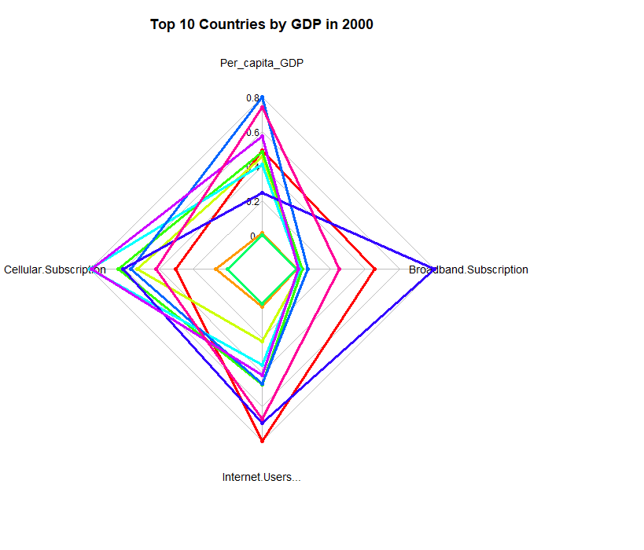
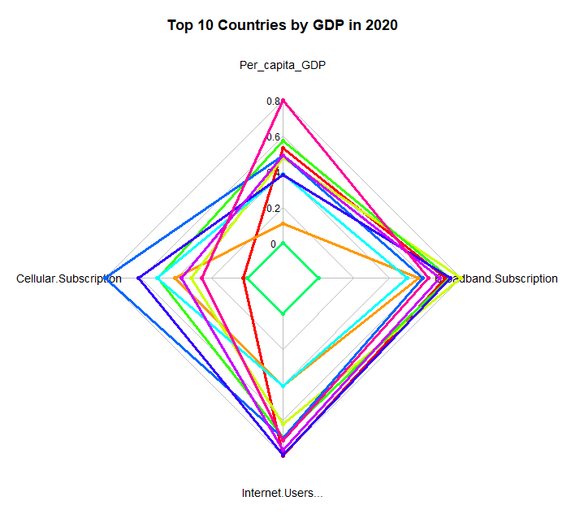
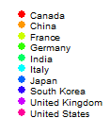
Comparison of Multiple Variables
for the Top 10 Countries by GDP in 2000 and 2020
Radar chart
Notes:
1. GDP per capita (Per_capita_GDP)
Ranking changes: Some countries have risen in the ranking of GDP per capita in 2020, such as China, showing the relative improvement of their economies relative to other countries.
Relative position: Developed countries (such as the United States and Canada) still rank higher, but some countries that have risen due to economic reforms are gradually approaching.
Narrowing gap: The gap between some developing countries and developed countries has narrowed to some extent.
2. Cellular subscription (Cellular Subscription)
Ranking rise: Some countries have improved their rankings in cell phone subscriptions, indicating that they have made progress in mobile communication penetration.
Decline of old powers: Some traditional powers (such as Japan and Germany) may decline in the ranking, reflecting the rise of other emerging market countries.
Market changes: Market competition and technological progress have led more countries to achieve relatively good performance in cell phone subscriptions.
3. Internet users (Internet Users)
Improvement in user penetration: Changes in the ranking of Internet users show the development potential of those new Internet markets (especially developing countries).
Balanced development: Some countries (such as India) have risen in the ranking of Internet users, reflecting the improvement of their Internet infrastructure and usage.
Solid position of developed countries: Although some countries have dropped in the ranking, developed countries still maintain their relative advantage in the number of overall Internet users.
4. Broadband Subscription
Ranking adjustment: Some countries have improved their ranking in broadband subscription, showing their progress in improving broadband infrastructure.
Competitiveness change: Developing countries are gradually approaching developed countries in terms of broadband subscription rates, showing the rapid development of their markets.
Relative position maintenance: Developed countries still maintain their relative ranking in broadband subscription, reflecting the stability of core markets.

Slide 15
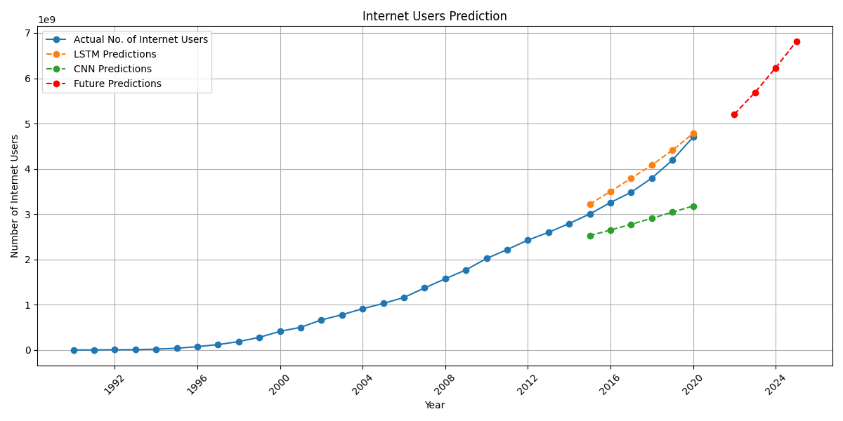
Internet Users Prediction
STEP1
Use CNN for Prediction
STEP2
Use LSTM for Prediction
STEP3
Compare the Two Models:
LSTM won
The number of users is expected to increase sharply in the coming years, especially between 2022 and 2024.
Notes:
1. Modeling steps:
Step 1: Use CNN for Prediction: Although CNNs are primarily used for processing image data, they can extract local features from time series data by converting it into one-dimensional images, allowing for predictions. Therefore, we first use CNN for prediction as discussed in class.
Step 2: Use LSTM for Prediction: LSTM is a type of recurrent neural network (RNN) specifically designed to handle sequence data and capture long-term dependencies in time series. Thus, we use LSTM for prediction.
Step 3: Compare the Two Models: We will determine the optimal model using the evaluation metric RMSE, predict the number of internet users from 2021 to 2024, and plot a line graph.
2. Model comparison
MSE is the average of the squared differences between predicted and actual values, while RMSE is the square root of MSE, providing an error measure in the same units as the original data. The RMSE of LSTM (0.0987) is also significantly lower than that of CNN (0.2256), further demonstrating the higher accuracy of LSTM's predictions. Although the R² of LSTM (0.3458) is below 1, it indicates that the model can explain some of the data variability. In contrast, the R² of CNN (-2.4177) is negative, meaning that this model performs poorly, even worse than a simple average prediction. This also suggests that CNN is not suitable for time series forecasting.
The green line represents the CNN's predictions on the test set, while the orange line represents the LSTM's predictions. It is evident that the LSTM's predictions on the test set are closer to the actual values. The red line shows the LSTM's predictions for the years 2021-2024.
3. Result analysis
(1) The evaluation metric for LSTM (with a low RMSE) indicates that this model can make a good prediction of future internet usage trends for reference.
(2) The predictions for the coming years (2021-2024) show a very strong growth trend, especially between 2022 and 2024, where the number of users is expected to increase sharply. This prediction reflects the ongoing expansion and application of the internet in the global market, which aligns with real-world trends.

Slide 16
Real-world Implications
This study may help businesses in internet related disciplines to plan new marketing strategies and detect further markets.
It may also help researchers to find patterns between the economic status and the internet adaption of a country.

Slide 17
Part three
Summary and conclusion
Future directions

Slide 18



Summary and Conclusion
Global Internet users：
uses the Internet protocol suite (TCP/IP) to communicate between networks and devices.
Animation of tableau graphics,
pie chart, bar chart, radar chart, time-series plot, violin plot, and correlation matrix
Special Findings to Highlight
The correlation between GDP and the internet user percentage is actually lower than expected.
The United States is not in the top 10 countries with highest internet user penetration rate in the year 2020.
1
2
3
4
5
6
Real-life scenario:
Assist people in related industries/research areas to make decisions and use.
Data visualization helps us analyze the data and interpret the results more efficiently.

Slide 19
Future Directions
Add data from 2021-2024 to see if our predictions are accurate
Study the enhancement of the Internet by the development of 5G technology in recent years and the changes in the Internet user landscape
Use some techniques that we haven't learned in class to create better visual effects

Slide 20
THANK YOU FOR YOUR LISTENING

